Slide 1
Introduction to Dynamic Programming
Md Mehrab Hossain Opi

Slide 2
Recursion Revisited
A programming concept where a function calls itself.
Solves a problem by breaking it down into smaller, more manageable instance.

Slide 3
Key Characteristics of Recursion
Base Case
Smallest instance that can be solved directly.
Prevent recursion from running indefinitely.
Recursive Case
Calls itself with a modified version.
Combines result of recursive calls to solve actual problem.

Slide 4
Recursion Example
Sum of the series 1,2,…,N.
Let f(N) be the function that returns the value
1+2+…+N
Then
f(1) = 1
f(2) = 1 + 2
f(3) = 1 + 2 + 3
f(4) = 1 + 2 + 3 + 4
f(5) = 1 + 2 + 3 + 4 + 5

Slide 5
Recursion Example
Let us try to convert the equations to apply recursion
f(1) = 1
f(2) = 1 + 2 = f(1) + 2
f(3) = 1 + 2 + 3 = f(2) + 3
f(4) = 1 + 2 + 3 + 4 = f(3) + 4
f(5) = 1 + 2 + 3 + 4 + 5 = f(4) + 5
.
.
.
f(N) = 1+ 2 + … + N = f(N-1) + N

Slide 6
Recursion Example
Let’s try to write a program to solve the problem.
Base Case
Recursive Case
if (N==1) return 1
return N + f(N-1)

Slide 7
Recursion Example
Complete recursive function
int sumUptoN(int N){
if(N==1) return 1;
else
return N+sumUptoN(N-1);
}

Slide 8
Another Example
Let us look at another example now.
Fibonacci Sequence
0, 1, 1, 2, 3, 5, 8, 13, 21, 34, …..
Except for the first two elements, all elements are the sum of previous two elements.
Let Fib(N) be the function to calculate N’th Fibonacci number.

Slide 9
Fibonacci Sequence
Using recursion we can define the function as
Fib(0) = 0
Fib(1) = 1
Fib(2) = Fib(0)+ Fib(1)
.
.
.
Fib(N) = Fib(N-2)+ Fib(N-1)

Slide 10
Fibonacci Sequence
A equivalent function to calculate the Fibonacci number.
int Fib(int N){
if(N==0) return 0;
else if(N==1) return 1;
else return Fib(N-1)+Fib(N-2);
}

Slide 11
Fibonacci Sequence
Let’s try to calculate Fib(5).
For better understanding we will use recursion tree.

Slide 12
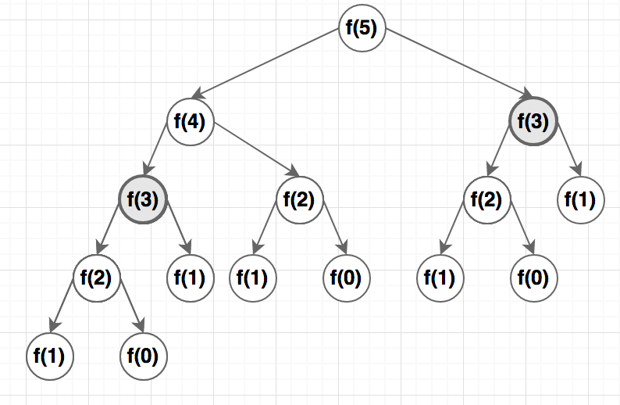
Fibonacci Sequence

Slide 13
Fibonacci Sequence
Fib(3) is calculated twice.
To optimize our code we want to avoid repeated calculation.

Slide 14
Fibonacci Sequence
If we can store the calculated values we can avoid recalculation.

Slide 15
Fibonacci Sequence
int calc[MAXN];
int Fib(int N){
if(n==0) return 0;
if(n==1) return 1;
if(calc[n]!=-1){
return calc[N];
}
calc[N] = Fib(N-1+Fib(N-2);
return calc[N];
}
void init(){
for(int i=0;i<=MAXN;i++){
calc[i] = -1;
}
}
int Fib(int N){
if(N==0) return 0;
else if(N==1) return 1;
else return Fib(N-1)+Fib(N-2);
}

Slide 16
Dynamic Programming
Algorithm technique
Breaks problem into smaller subproblem.
Uses the solution of subproblems to solve the actual problem.
Uses a data structure to store the solutions of the subproblem.

Slide 17
Dynamic Programming
Key properties
Overlapping subproblems: The problem can be broken down into subproblems that are solved repeatedly.
Optimal Substructure: The optimal solution to the problem can be obtained by combining optimal solutions to its subproblems.

Slide 18
Coin Change Problem
Suppose you have some coins/notes with the cost
C₀, C₁, C₂, …, C_{n}.
You are also given an amount W.
You need to tell the number of minimum coins needed to make W.

Slide 19
Coin Change Problem
For example, let C = {2, 5, 9, 13, 15}.
Let W = 22.
What will be the minimum number of coins to make W?
We can take 15, 5, and 2 to make 22.
We can also make 22 with 13 and 9, which is the minimum.
How do we solve the problem?

Slide 20
Greedy Approach
We might try to take larger coins to make the amount of coin smaller.
But when we started with 15 we needed 3 coins.
So we can’t use greedy approach.

Slide 21
All Possible Ways
What if we could check all possible ways to check coins?
In how many ways can we take coins from 5 coins?
We can take 1 coin in 5C1 ways.
We can take 2 coins in 5C2 ways.
We can take 3 coins in 5C3 ways.
So we have 5C1+5C2+5C3+5C4+5C5 ways.
This is equal to 2⁵-1.
How do we implement this?

Slide 22
A Slightly Different Problem
Let’s try to solve a similar but easier problem first.
Is it possible to make W using the coins given?

Slide 23
Applying Recursion
For each coin we have two choices
We either take it
Or we don’t.
Let’s define S as the sum of the coins we have taken.
If we take a coin S will increase.
When will we end our recursion? (Base Case)
When we have no more coins to take.
We have reached the end of list.

Slide 24
Applying Recursion
Let’s try to define our recursion function now.
What will be the parameters of the function?
To check base case condition we need the index of current coin.
We also need the sum (S) to compare with W.

Slide 25
Recursive Function
Let F be the recursive function.
The function declaration will be then
What does the function imply?
It returns true if it is possible to achieve W when
We are at position index.
And we have current_sum changes.
bool F(int position, int current_sum);

Slide 26
Recursion Function
vector<int>coin;
int n; // number of coins.
bool F(int position, int current_sum){
if(current_sum==W) return 1;
//Base Case
if(position==n) return 0;
//Recursive case
bool take_coin = F(position+1, current_sum+coin[position];
bool dont_take = F(position+1, current_sum);
return take_coin | dont_take;
}

Slide 27
Applying Dynamic Programming
How can we convert the recursive problem into dynamic programming?
To avoid repetitive calculation we need to store the calculated values.
We need a 2d matrix now.

Slide 28
Memoization
vector<int>coin;
int n; // number of coins.
int table[MAX_C][MAX_W]; // initialized to -1
bool F(int position, int current_sum){
if(current_sum==W) return 1;
//Base Case
if(position==n) return 0;
//check if already calculated
if(table[position][current_sum]!=-1)
return table[position][current_sum];
//Recursive case
bool take_coin = F(position+1, current_sum+coin[position];
bool dont_take = F(position+1, current_sum);
return table[position][current_sum] = take_coin | dont_take;
}

Slide 29
Original Problem
Let’s come back to our original problem.
We need to find the number of minimum coins.
When we take a coin our number of coin increases by 1.
If it is not possible to make W at all we should return something that indicates it.
We will use INF to indicate impossible.

Slide 30
Coin Change Implementation
vector<int>coin;
int n; // number of coins.
int table[MAX_C][MAX_W]; // initialized to -1
int F(int position, int current_sum){
if(current_sum==W) return 0;
if(position==n) return INF;
//check if already calculated
if(table[position][current_sum]!=-1)
return table[position][current_sum];
//Recursive case
int take_coin = 1 + F(position+1, current_sum+coin[position]);
int dont_take = F(position+1, current_sum);
return table[position][current_sum] = min(take_coin, dont_take);
}

